Slide 1
Autumm show 3 nov. 24

Slide 2
Showmanship at halter
*Hunter kids & beginners
Startlijst nummer 0 en 6

Slide 3
Showmanship at halter
*amateur & open
Startlijst nummer 7 & 8

Slide 4
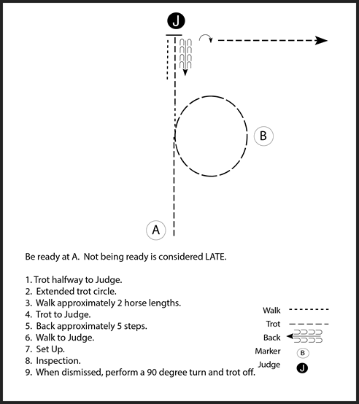
Horsemanship
Kids leadline / beginners
Startlist nummer 3 -19

Slide 5
Horsemanship
Amateur / open
(*startlijst nummer 20)
1: trot halfway to judge
2: extended trot circle
3: lope Left Circle
4: trot to judge
5: stop, backup 1 horse length.
6: walk to judge
7: 450 degree turn R.
8: trot off.

Slide 6
pleasure
Kids op muziek. Stop en go walk / jog /stop
Startlijst nummer: 4
Pleasure walk en jog: statlijst nummer 16
Pleasure amateur startlijst 17
Pleasure open startlijst 18

Slide 7
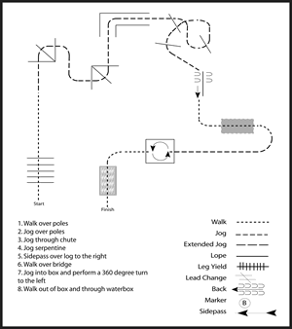
In hand trail green & trail
Kids leadline trail & in hand trail
#zelfde pattern.
Startlijst nummer 1-2- 11-22
1: walk over poles
2: jog over poles
3: jog through chute
4: jog sepetine poles
5. Walk past the mailbox, stop en backup next to mailbox.
6: open en close mailbox continue in walk.
7: jog into box and perform 360 turn. ( 1 direction of choice)
8: walk out , walk over and finish.

Slide 8
trail open
#zelfde pattern.
Startlijst nummer 13
1: walk over poles
2: jog over poles
3: jog through chute
4: LOPE sepetine poles
5. Walk past the mailbox, stop en backup next to mailbox.
6: open en close mailbox continue in walk.
7: jog into box and perform 360 turn. ( 1 direction of choice)
8: walk out , walk over and finish.

Slide 9
Ranch trail GREEN
#zelfde pattern.
Startlijst nummer 25
1: walk over poles
2: jog over poles
3: serpetine to gate
4: work the gate
5: backup L.
6: walk out en walk in trough sute
7: sepetine poles jog
8: Walk past the mailbox, stop dismount, tiedouwn.
9: sit and warm your hands on the fire.
10: walk to your horse and walk over bridge.

Slide 10
Hunter under saddle: pleasure proef in Engelse stijl
Startlijst nummer 28

Slide 11
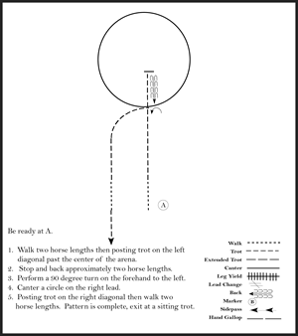
Hunt seat equitation (startlijst nummer: 29)
1: vertrek in stap naar x.
2: na enkele meters draf lichtrijden op het linker been
3: stop en achterwaarts.
4: 1 kwart draai naar links op de voorhand.
5: volte in galop rechts.
6: op x in draf op het rechterbeen lichtrijden.
7: na 2 paardlengtes doorzitten en in stap.

Slide 12
Ranch rail: pleasure op de ranchstyle.
Startlijst nummer 30

Slide 13
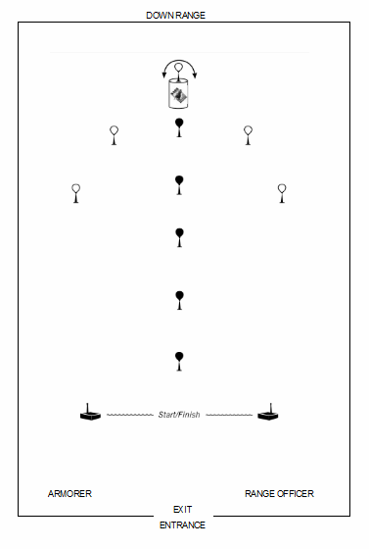
Mounted shooting:
Start met zwart. Ga om de barrel/ton
Daarna schiet je wit 2x
Om de ton de andere witte.
Terug naar finish.
Eigen keuze door eerst links of rechts te gaan.
(startlijst nummer:31)

Slide 14
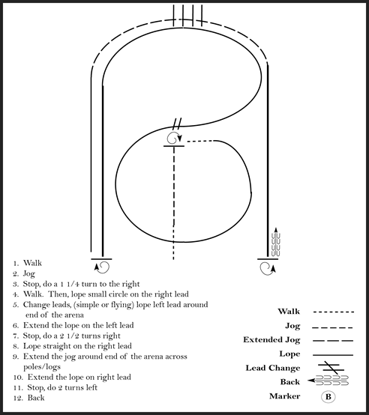
Ranchriding
amateur / open
Startlijst nummer: 34

Slide 15
Einde patterns, suc6 met oefenen!

Slide 16
Longe-Line The longe line portion of the class is a minute and a half. At 45 seconds, a whistle will blow to alert you it is halfway over. At the end of 90 seconds, time is called. Pay attention to your judges’ and ring stewards’ instructions. You have the judges’ attention for 90 seconds, so you want to make the best impression possible.

Slide 17
Ranchriding
beginners
1: jog
2:stop 3/4 turn L. continue in walk.
3: trot circle & figure S.
4: extended trot
5: stop turn 180 R.
6: lope
7: extended jog over.
8: jog, stop,
9: backup

Slide 18
1: gate
6: jog over, jog between poles, jog over
2: serpetine jog
3: lope to L
pro tail.
open
5: walk over
4: back up L, jog out
7: side pass
9: jog in box , stop ,
360 turn , walk out.
8: walk over bridge

